Slide 1
Aspect based emotion analysis
Kunal Verma, Nimesh Aggarwal, Niteesh Kumar
203050121, 203050049, 203050065
-10th December 2020

Slide 2
Aspect based emotion analysis
Aspect based emotion analysis aims to extract various aspects of reviews and determine the corresponding emotion for each aspect category. The term ‘aspect’ refers to an attribute or a component of the product
Instead of classifying the overall emotion of a review into anger, sadness, happiness, surprise and joy aspect-based analysis allows us to associate specific emotion to different aspects of a product and such a analysis provides greater insight to the emotions expressed in the written reviews.
Dataset : SemEval (2014 and 2016) dataset(Restaurant)

Slide 3
Problem
No aspect based emotion tagged dataset available
Verification of results?
Dataset:
SemEval 14 and 16 of Restaurant reviews
Aspect labelled as Positive, Negative or Neutral in the dataset.
Aspects can be multiple words also.
Not each sentence may have a aspect present.

Slide 4
Solution
Dataset is tagged using sentiments <Positive , Negative ,Neutral > for each aspect Identified in the sentence.
We used the backmapping approach to evaluate the solution.
Emotions Identified for each aspect were classified as Positive , Negative and Neutral.
Then above mapping was used to evaluate the result.

Slide 5
Pipeline
Data Pre-processing
We have done preprocessing for all the reviews in the dataset by removing unwanted characters,links etc.
Example : Not only was the food outstanding, but the little 'perks' were great.
After preprocessing :not only was the food outstanding but the little perks were great
Aspect Terms Extraction
Each token of review is marked with B,I,O encoding scheme.where B, I and O denote the beginning,inside and outside entities of aspect terms
We have used a CRF(Conditional Random Field) to classify the aspect terms
The classifier is trained with the following set of features: a)word information,b)Part-of-Speech (PoS) tag information c)previous chunk label information,d)Prefixes and suffixes information
We were able to achieve an accuracy of 80%
Output : ['O', 'O', 'O', 'O', 'B-A', 'O', 'O', 'O', 'O', 'B-A', 'O' 'O']
Aspects : ['food', 'perks']

Slide 6
Pipeline
Dependency word extractor from aspects
Extracted emotion related words using stanford nlp stanza dependency parser
Emotion Tagger based on the words extracted
Tagging all the aspects with a particular emotion based on the dependent words extracted
4 different types of emotion tagging methods
NRC Lexicon
text2emotion library
Tf-idf SVM based
Logistic Regression
Mapping the aspect emotion to positive or negative polarity
Trust, surprise, happy, joy - positive
Fear, anger, disgust, sadness - negative

Slide 7
Results
NRC Lexicon
Precision = 0.697
Recall = 0.497
f1-score = 0.580
Text2emotion
Precision = 0.643
Recall = 0.458
f1-score = 0.535
SVM
Precision = 0.620
Recall = 0.442
f1-score = 0.516
Logistic Regression
Precision = 0.674
Recall = 0.480
f1-score = 0.561

Slide 8
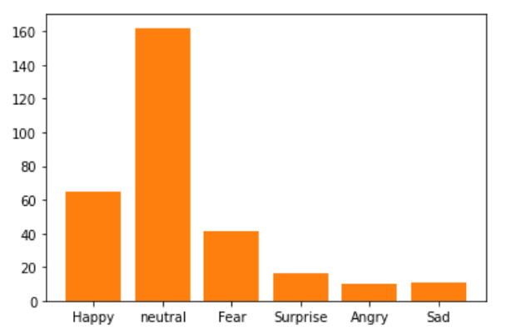
Analysis
Aspect extraction module is efficient in detecting aspects correctly most often with an accuracy of 80% as stated before
The emotion tagger module for all 4 different methods are detecting ‘neutral’ most frequently which is not actually the case
This is attributed to the dependency words that were extracted were only part of sentences/words which are not well defining or explaining that aspect
Dependency words extractor part -Bottleneck
Improving or changing methodology
Using other DL/attention based methods can be looked into

Slide 9
Future Scope
The dependency word extractor can be modified using Deep learning based methods such as attention framework to take into consideration all the context present around the aspects
Combining with the current sentiment analysis techniques to have a better classification of emotion
Aspect based Emotion tagged dataset can be useful for various paradigms of emotion and sentiment analysis

Slide 10
Assignment 3: Constituency parsing
Tools Used:
Benepar parser for generating constituency parse tree
Input: Sentence string
Output: CP tree object
Example:
Input String:
Vinken will join the board as a nonexecutive director
Output: tree object in the below form
(S
(NP (NNP Vinken))
(VP
(MD will)
(VP
(VB join)
(NP (DT the) (NN board))
(PP (IN as) (NP (DT a) (JJ nonexecutive) (NN director))))))

Slide 11
Assignment 3: CP to DP
Paper Reference:
Johansson, Richard, and Pierre Nugues. "Extended constituent-to-dependency conversion for English." (2007).
Methodology: (from lecture slides - Speech and Language Processing, Jurafksy & Martin, Ch-15, 2019)
Mark the head child of each node in a phrase structure, using the appropriate head rules.
In the dependency structure, make the head of each non-head child depend on the head of the head-child.

Slide 12
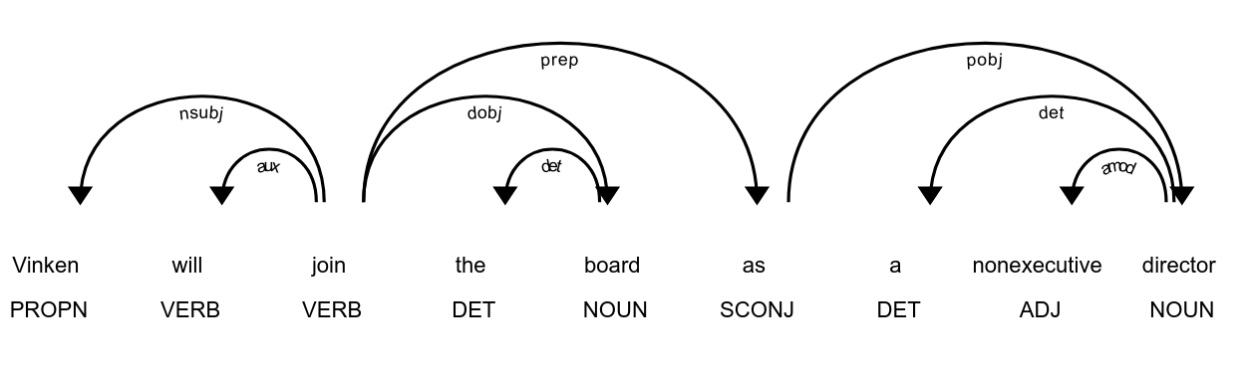
Assignment 3: CP to DP (Output examples)
INPUT: Vinken will join the board as a nonexecutive director
OUTPUT: Actual code output
Head == Label ==> modifier
join == nsubj ==> Vinken
join == aux ==> will
join == dobj ==> board
join == prep ==> as
board == det ==> the
as == pobj ==> director
director == det ==> a
director == amod ==> nonexecutive
Actual output for verification using spacy dependency parsing

